Slide 1
Successful Grant Writing
for the Education Foundation

Slide 2
Remember back to when you were a kid…
How did you learn? Visually? Orally? Through projects?
Hands-on activities? Technology?

Slide 3
Choosing Your Project
Be creative & innovative
*If it has been implemented at another campus, tell us why it’s innovative for your campus. If a grant has been successful, it’s a positive that you want it, too!
How many students does it impact vs. the amount invested?
Think about collaborating with another dept. or grade level – i.e.Art with Math
Is it sustainable? Stay away from: field trips, salaries, food & general consumables.
Use new technology, educational vendors to help you generate new ideas.
https://austinedfund.org/for-educators/innovation-grants/past-winners/

Slide 4
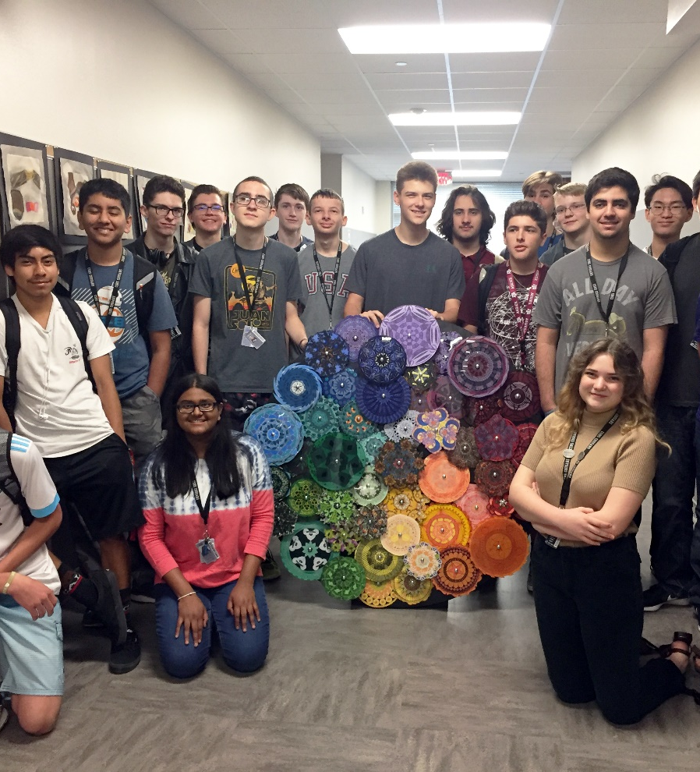
School Involvement Example -
Laser Art
This grant was a collaboration between the high school art & engineering students.
The final product was an art piece that was designed by art students and laser printed on a 3-D printer by the engineering students.

Slide 5
Grant Levels
Club Sponsor/Activity –Up to $1,000
Individual Teacher–Up to $2,500
Grade level, department or more than one teacher–Up to $7,500
Entire Campus–Up to $10,000
Multi-campus–Up to $15,000
District-wide impact–Up to $25,000

Slide 6
Online Grant Application
Givetokids.csisd.org
Applications are created through a third-party site called SmarterSelect.
You must create a username & password. The application can be
edited until you click submit.

Slide 7
Grant Overview
Grant Name – Be Creative! (but don’t use your campus name in the title)
Description – keep it short & to the point.
Amount Requested – make sure your amount matches your budget sheet.
Previously funded – has this grant been funded before? *Our board often wants to repeat successful grants at other campuses.

Slide 8
The Proposal
What is the current issue or area of improvement are you trying to address?
What will students learn?
What are the objectives you hope to accomplish? – Provide a snapshot!
Why does this project deserve funding and how will the grant provide the solution?

Slide 9
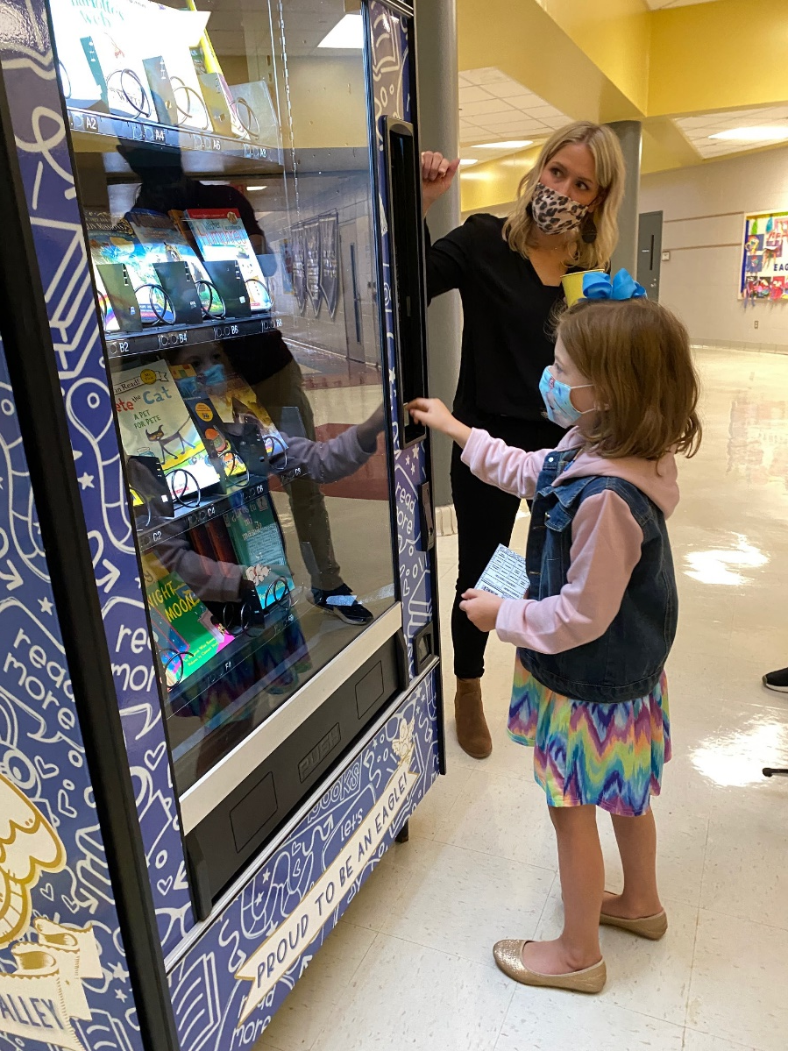
Literacy Treats for the Mind
This vending machine is placed in a prominent place in the school and dispenses high-interest books in a variety of levels and genres. Teachers will dispense tokens which can be used to reward good behavior & character traits as well as for need-based distributions.

Slide 10
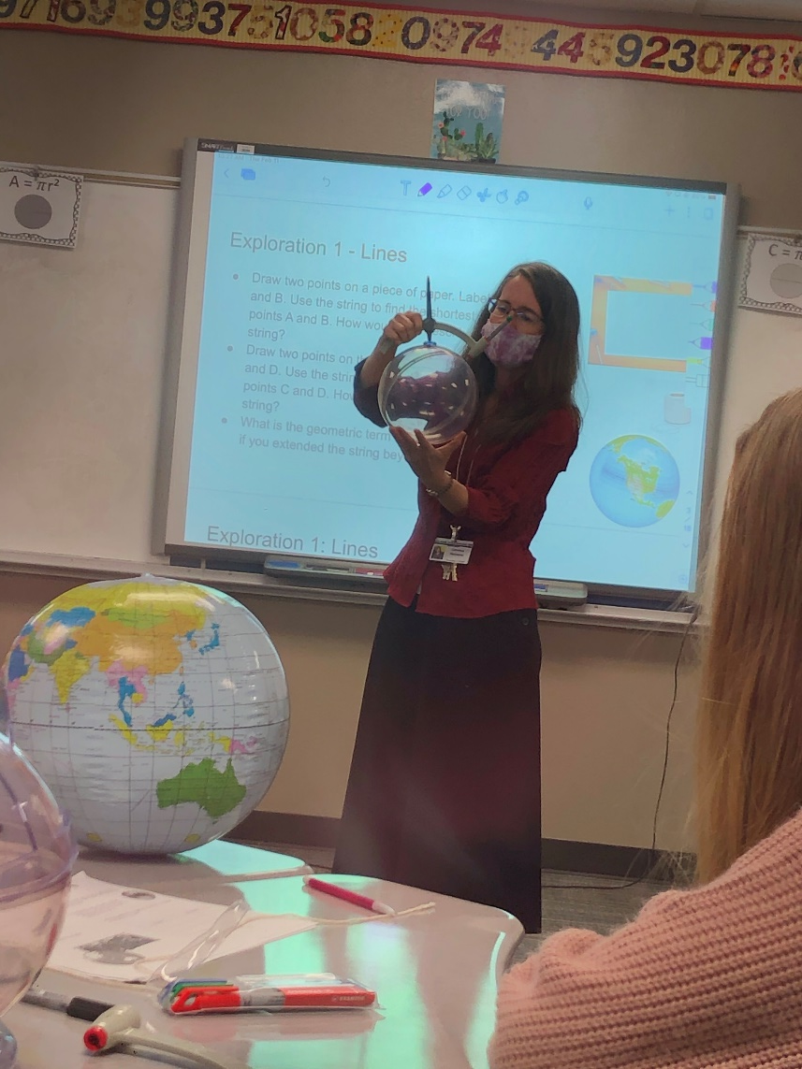
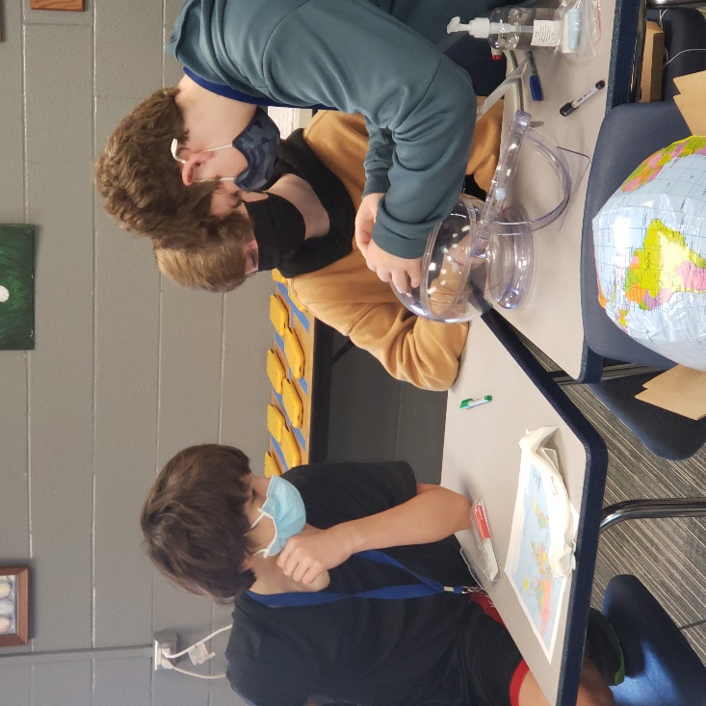
I’ve Got the Whole World in my Hands…
Teaching middle school and high school geometry students with manipulatives. Geometry is hard to study on a flat sheet of paper. These spheres can help student visually measure distances and angles.

Slide 11
Curriculum Methods
What are the goals and learning objectives?
What activities will engage and motivate learning?
Where and when will the
activities take place?

Slide 12
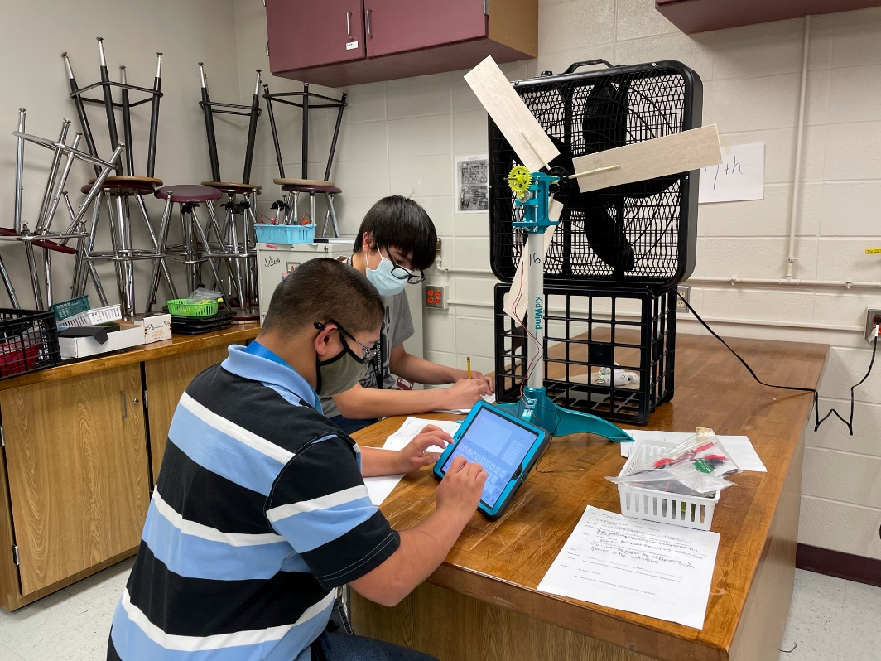
Making Energy a Breeze
Students will design, build and test wind turbines and other forms of renewable energy. Students will enjoy multiple hands-on activities. They generally have a difficult time knowing how generators and motors work. Students will build something that has clear, world application.
They also built in a friendly competition between groups to build a better turbine.

Slide 13
TEKS Requirement
Which TEKS does this grant service?
List the TEKS by number and include student expectation statement.
Is this an area that the district shows that it needs improvement?
Strategic Plan

Slide 14
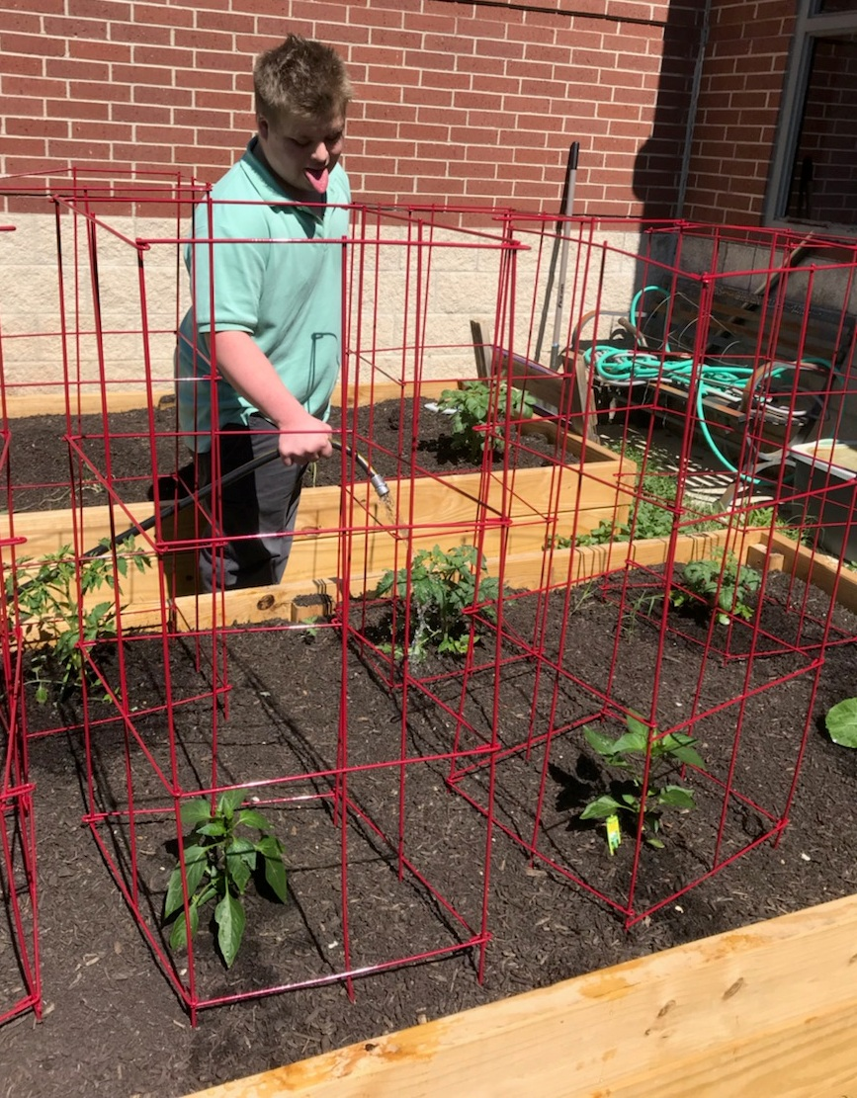
TEKS Requirements Example –
CSMS Living Garden Club
By helping to plant, grow, and maintain the CSMS garden, the Life Skills students as well as the students from the Garden Club will learn what makes a garden work.
Science - 7.5A (photosynthesis), 7.5B (cycling of matter through living systems, 7.5C (food chains and food webs, 7.7B (transformation of energy through digestion, 8.11B (organisms competing for biotic and abiotic factors), 8.11C (environmental changes and the effects on living things)

Slide 15
Innovation & Student Engagement
Why do you believe this grant is innovative?
How will this grant improve student engagement?
THIS IS IMPORTANT!

Slide 16
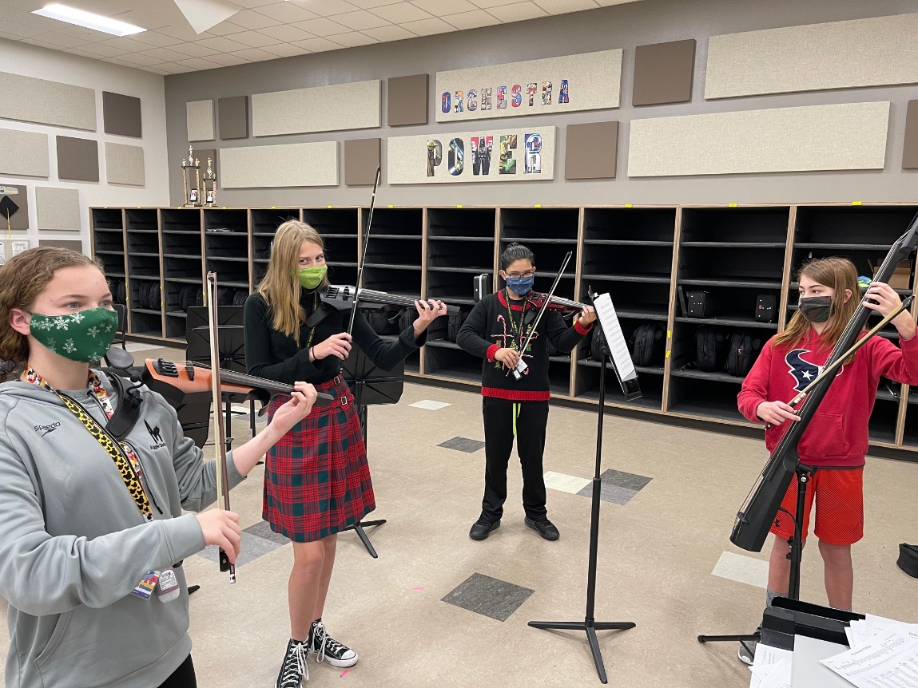
Orchestra is Electric
Electric instruments offer unique opportunities for students to blend their knowledge of traditional performance with modern technology and contemporary music. Instruments are share across campuses middle schools.

Slide 17
Evaluation & Follow-up
Indicate how you will show the project was successful.
Set criteria (Does not have to be test scores, can be testimonials, feedback from students, parents etc.)

Slide 18
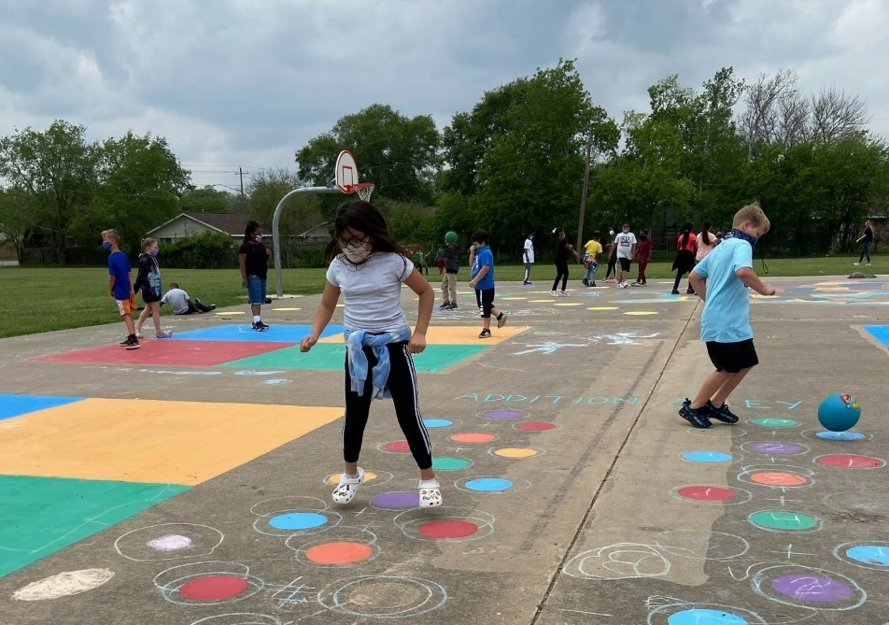
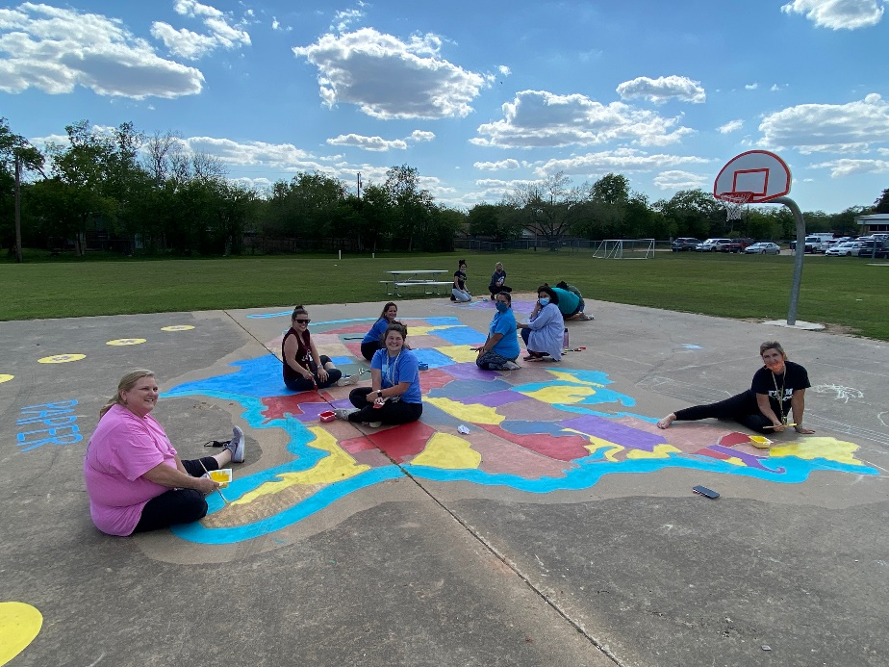
Hop, Skip & a Jump – Painted Playground
Sensory Paths
Games to play with balls
Maps
Reading & Colors
Words of Affirmation path
She used a Google Survey to ask teachers questions about engagement and success of the grant.

Slide 19
School & Community Involvement
Will the grant involve community members, other classes, teachers, campuses or partners?
Examples:
Multiple departments working together
PTO matching funding
Volunteers from the community

Slide 20
Supporting Information
Link to a video or picture
Research that backs your grant
Justification for resources

Slide 21
Budget Sheet
Develop a clear, realistic budget.
Get quote using Eduphoria.
Provide details of what is being purchased.
MUST USE APPROVED VENDORS
(CSISD Approved Vendors)
Don’t forget to include shipping if applicable.
Keep in mind the student to budget ratio. If you are requesting $5,000, how many students will be served?
Partially funded grants can occur.

Slide 22
Technology Approval
Must have technology approval if your grant contains technology (i.e. iPads, computers or software)
Submit quote using Eduphoria.
Once you have quote – submit technology approval form to David Hutchison, Director of Technology, by Friday, Sept. 24th.
4. Please give them at least one week turn around.

Slide 23
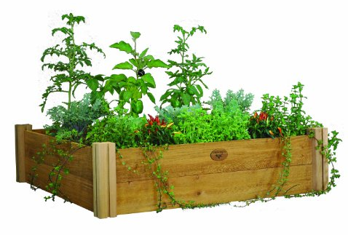
Facilities Approval
Must have facilities approval if your grant pertains to anything to do with facilities
(i.e. gardens, outdoor classrooms)
Submit to Rene Ramirez: rramirez@csisd.org by Sept.24th.
He will return it to you digitally with signature.
Please give them at least one week turn around.
Upload it to your application online.

Slide 24
Criteria Sheet ... What you’re graded on!
Program Design & Innovation
How many students are impacted and can it be used from year to year?
Is the need compelling?
Budget – Is it reasonable? Has it been padded?

Slide 25
Selection Process
Submit applications by midnight on Friday, Oct. 1st
through your online application on SmarterSelect.
Two rounds of evaluation
Curriculum staff
EF Board Members
Applications will either be approved, declined or
partially funded.
Applicants will be notified of decisions on November 16th during Grant Patrol

Slide 26
Final Thoughts
Use clear, concise language
The most important aspect of this project is how it will impact students of CSISD!
Keep your audience in mind when writing
Use test readers to review your application
Avoid using unexplained acronyms
If you have any further questions, please
email Teresa Benden at tbenden@csisd.org

Slide 27
Questions?
Don’t forget Grants are due October 1st!

