Slide 2
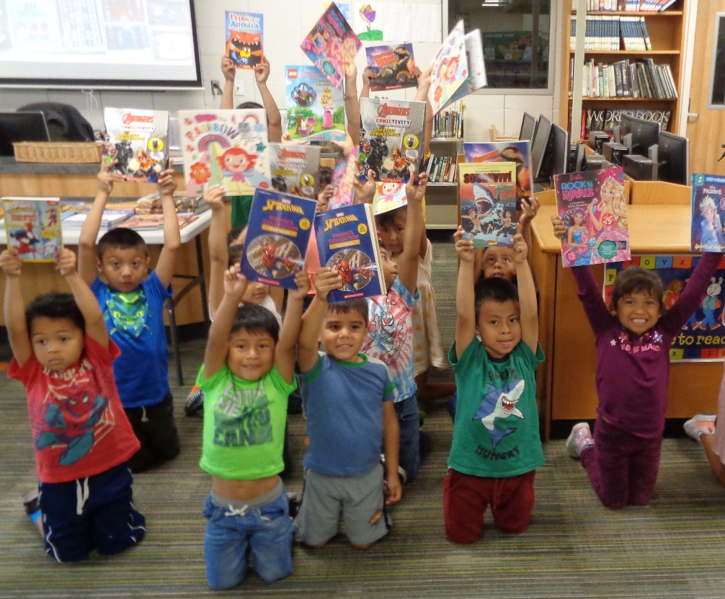
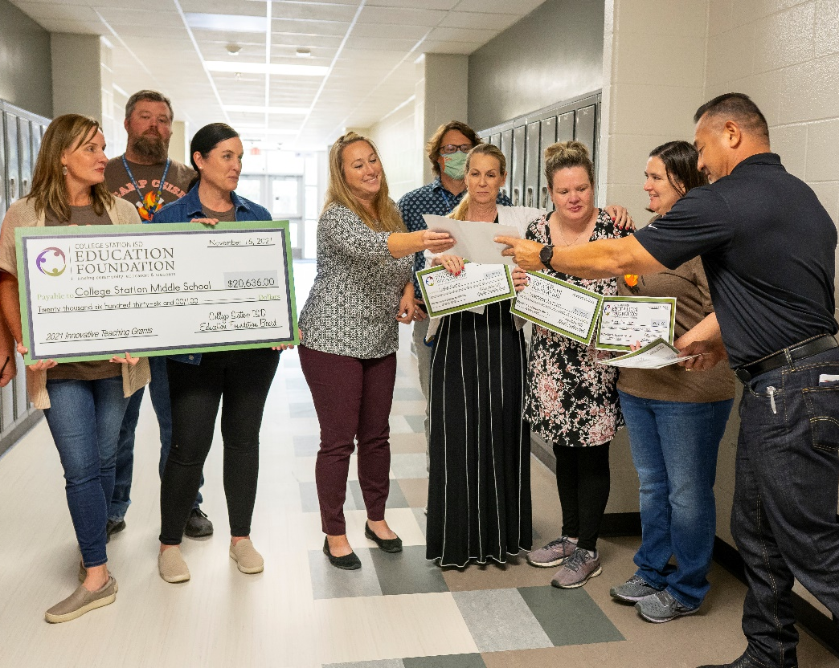

Slide 5
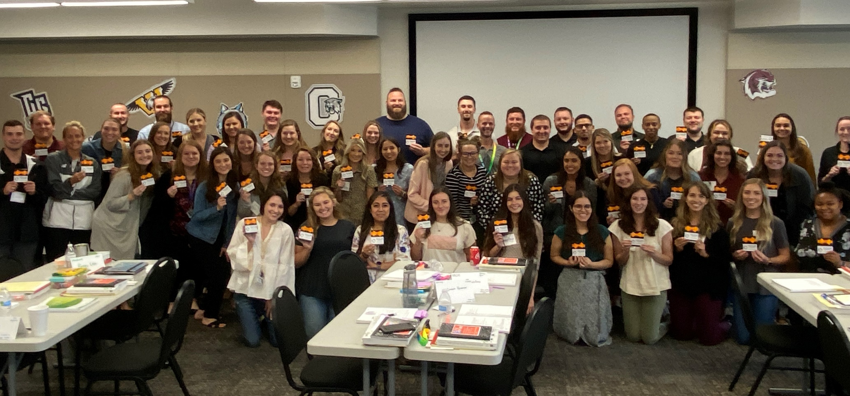

Slide 6
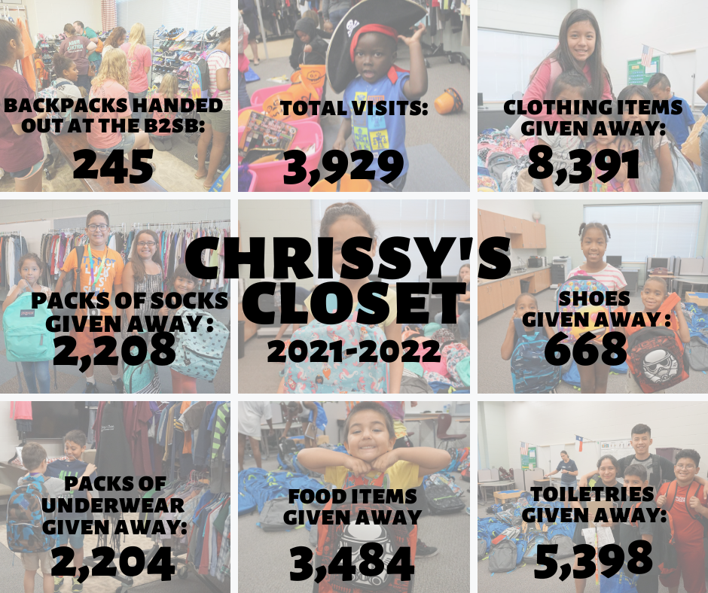
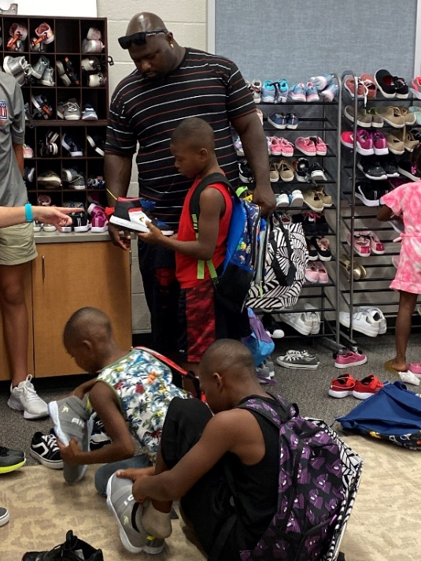
Title Sponsor
A free clothing store for CSISD students, families & staff

Slide 7
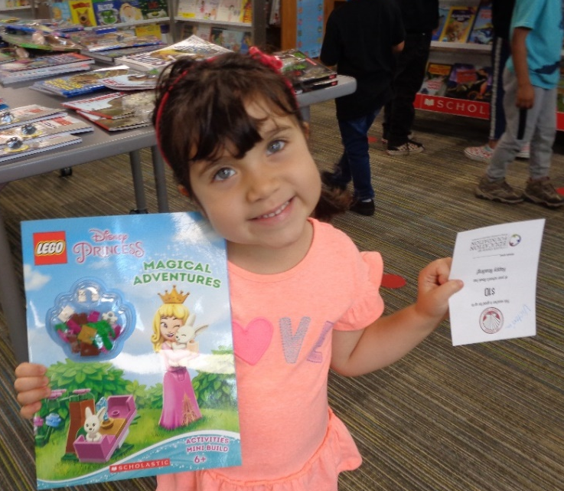
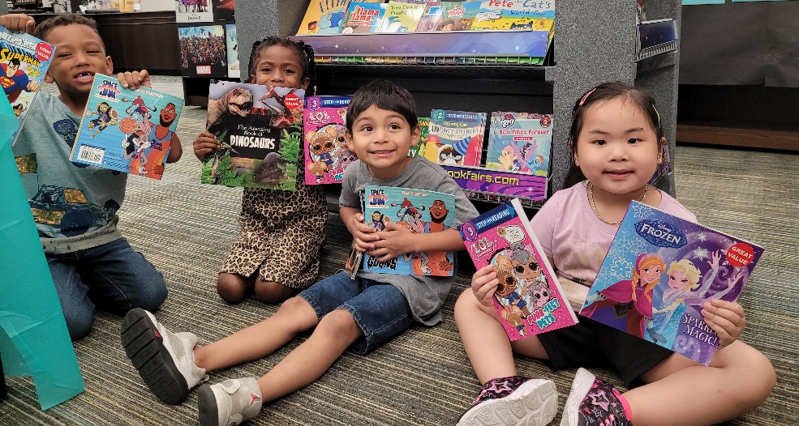
974 Pre-K, Head Start and Early Childhood Special Education students were given $10 book vouchers to purchase books of their choice at their schools’ book fairs.

Slide 8
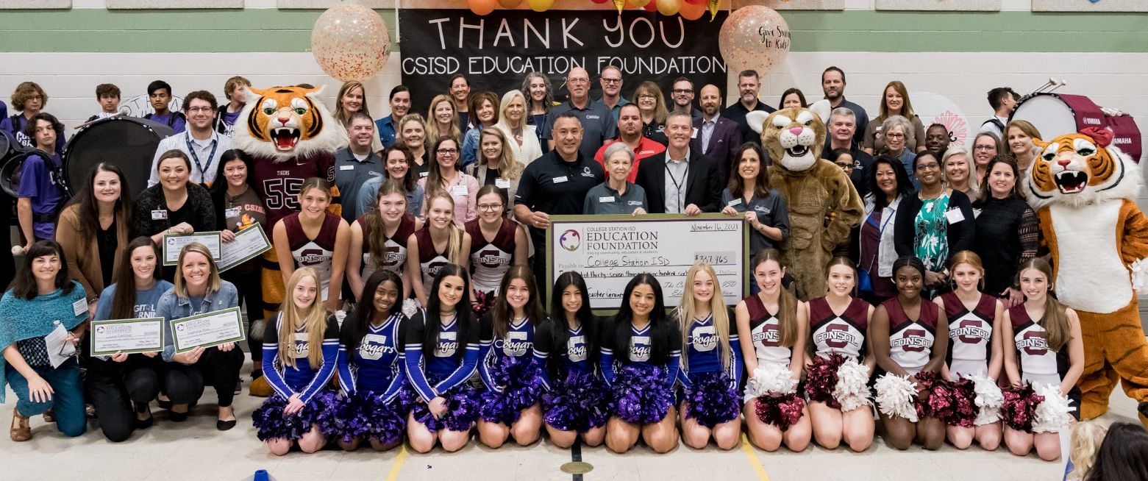
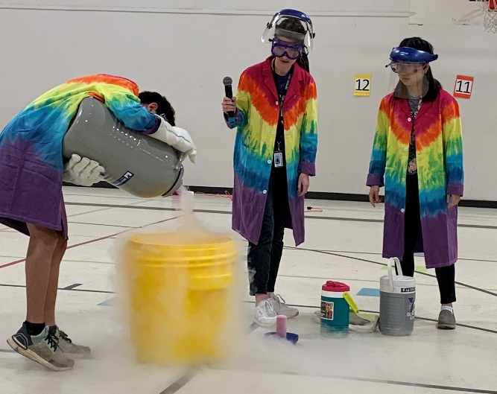
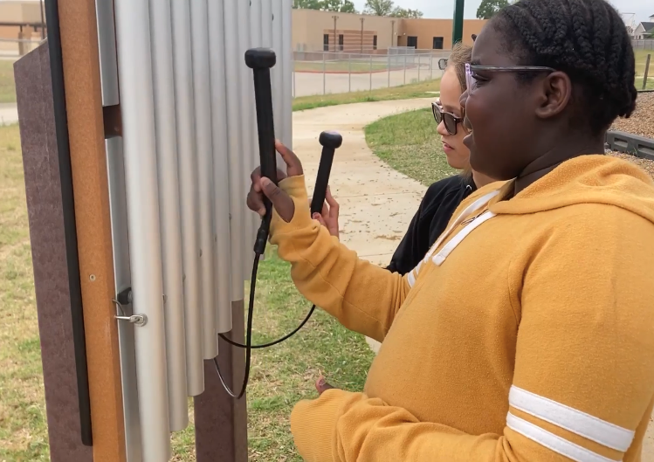
Title Sponsors
Awarded 70 grants totaling $337,965 last year
In 23 years,
686 grants have been awarded
totaling $1,993,099!

Slide 9
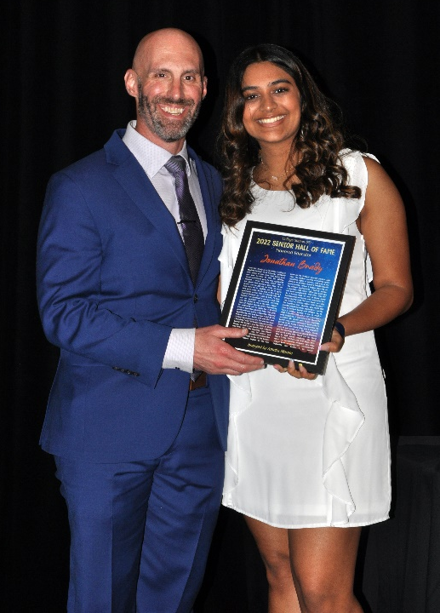
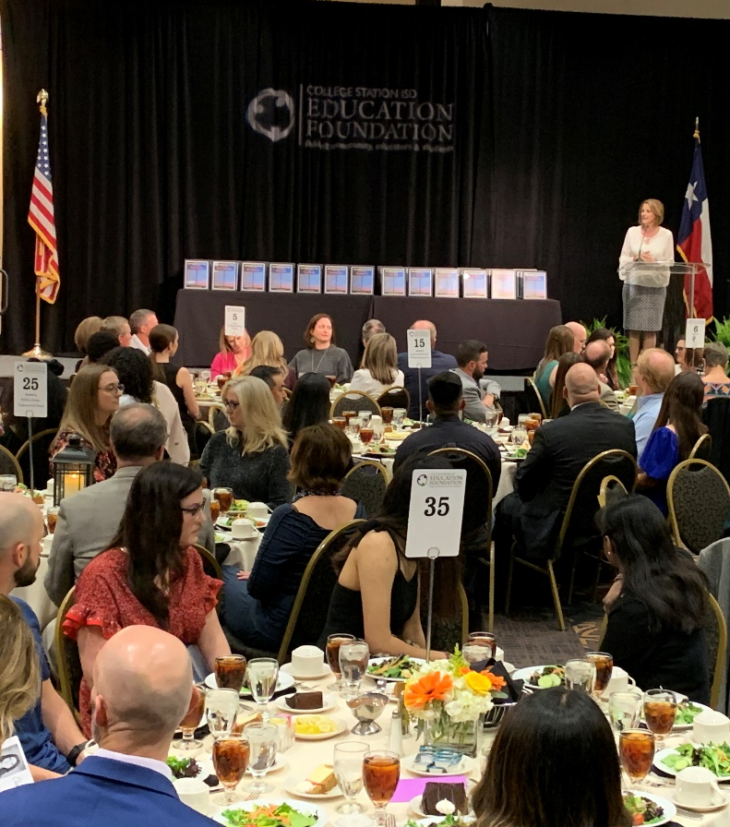
Recognized 67 outstanding seniors and their chosen educators. Seniors were selected based on integrity, leadership, dedication to their school and positive attitude.
1,102 students and their chosen educators honored since 2000
The Barrett- Ashfield Family

Slide 10
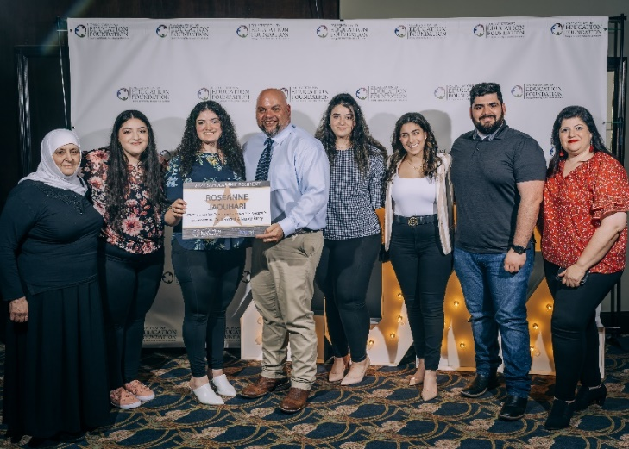
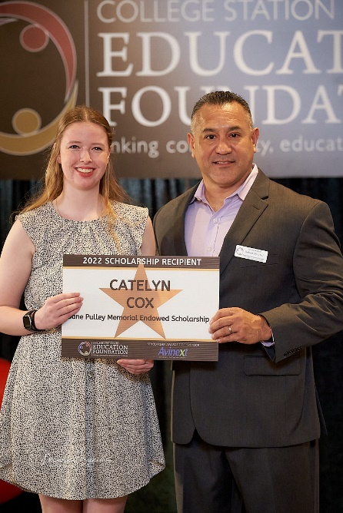
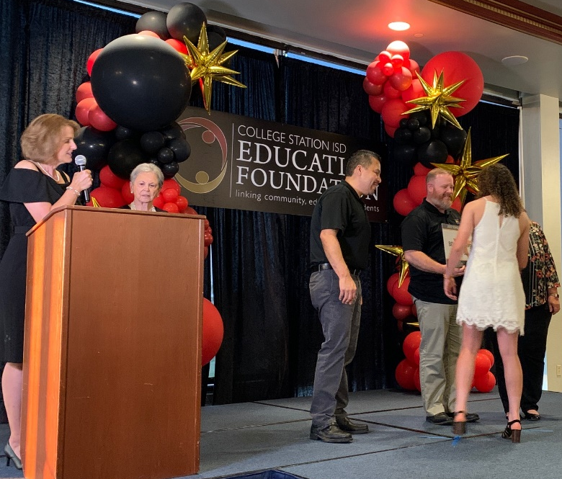
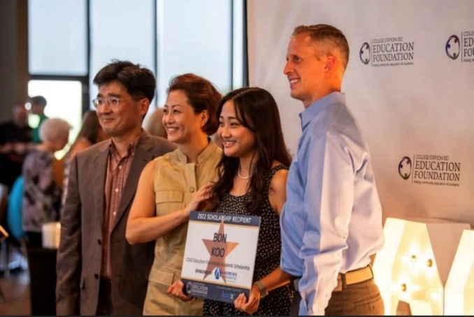
Awarded 115 scholarships totaling $154,300
Red carpet ceremony at Pebble Creek Country Club
Manage 20 Endowed scholarships worth $735,258
Awarded $961,650 over the past 23 years

Slide 11
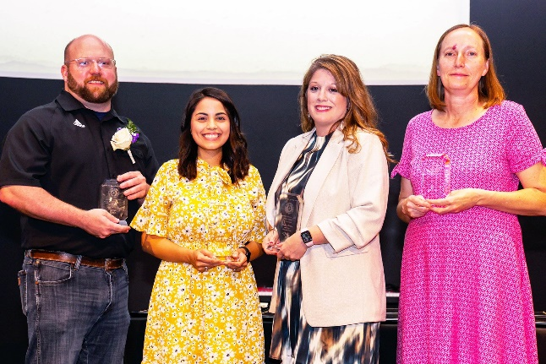
Star Educator
Title Sponsor
430 Teachers & Staff recognized last year
Recipients receive a pin, certificate & newspaper recognition
Title Sponsor
Teacher Appreciation
Contest during Teacher Appreciation Week
10 - $500 classroom grants given to winners
Title Sponsor
Annual Employee Awards
$11,000 in cash awards were given to elementary & secondary teachers of year, professional, paraprofessional and auxiliary staff of the year.

Slide 12
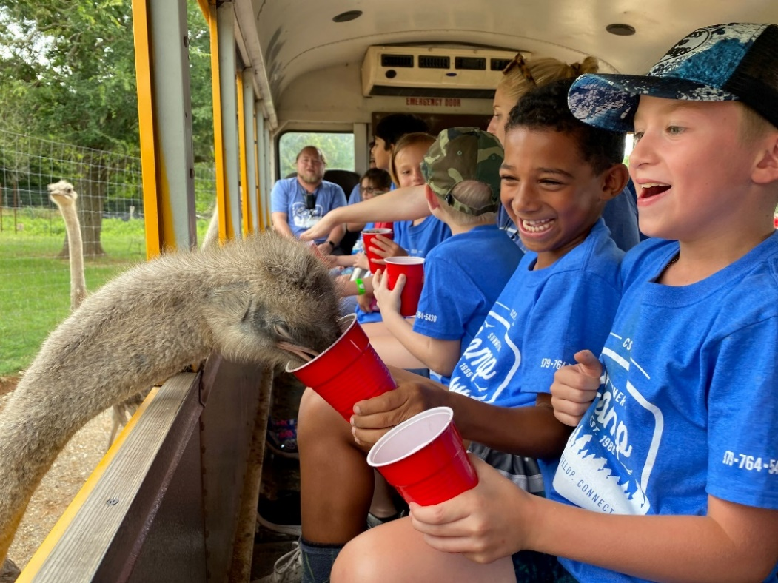
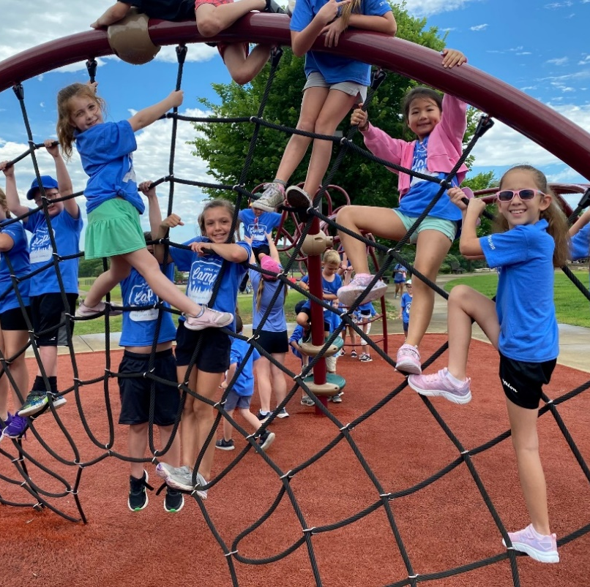
Program started in 2020 to send students in need to Summer Day Camp
Raised $31,550 which included employee giving $5.5K donor match
Sponsored 33 kids this summer for 10-week program at $1,436 per child. Family pays $10/week.
Leonard &
Nancy Berry

Slide 13
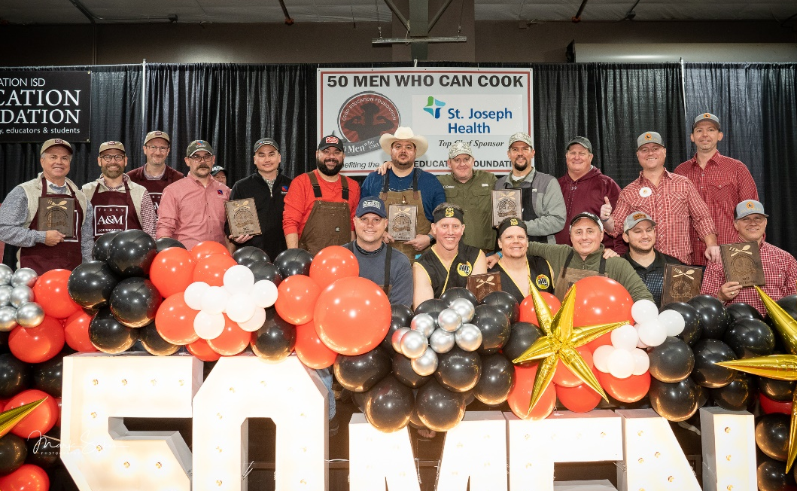
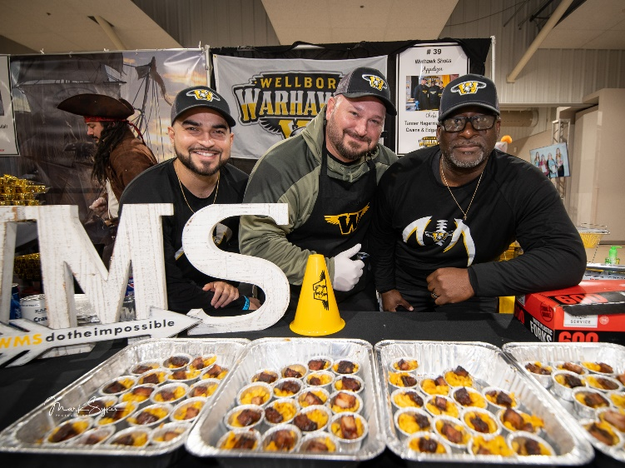
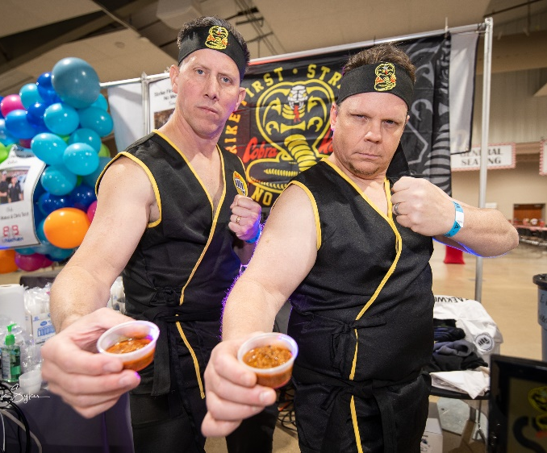
Raised $263,000 with 61 Celebrity Chef booths
Continues to be a community FAVORITE!

Slide 14
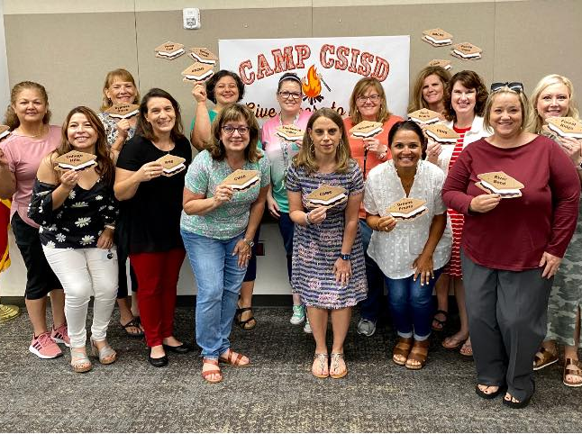
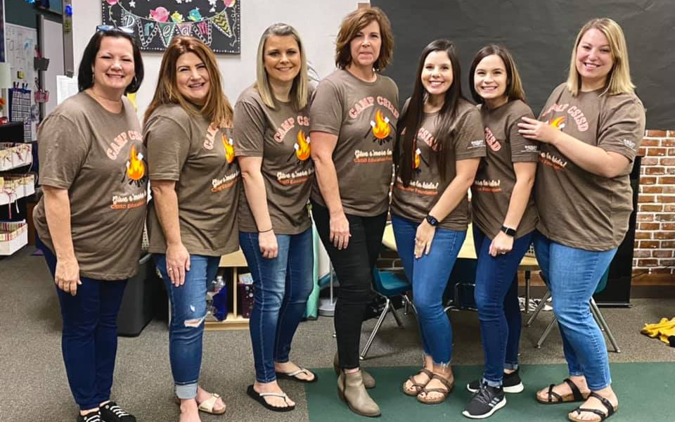
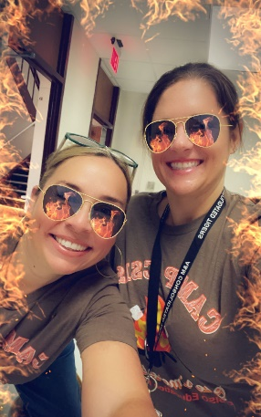
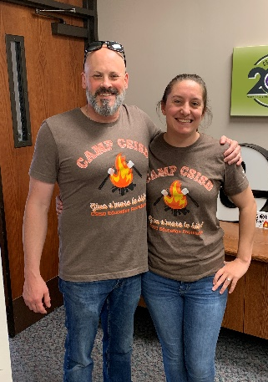
Total of $152,516 contributed for 2021-22
11th Annual Campaign
1,099 Employees giving (53% of employees)
7th year for Employee Rebate to campuses - $55,988 total unrestricted funds awarded to schools
2021-2022 Campus Champions

Slide 15
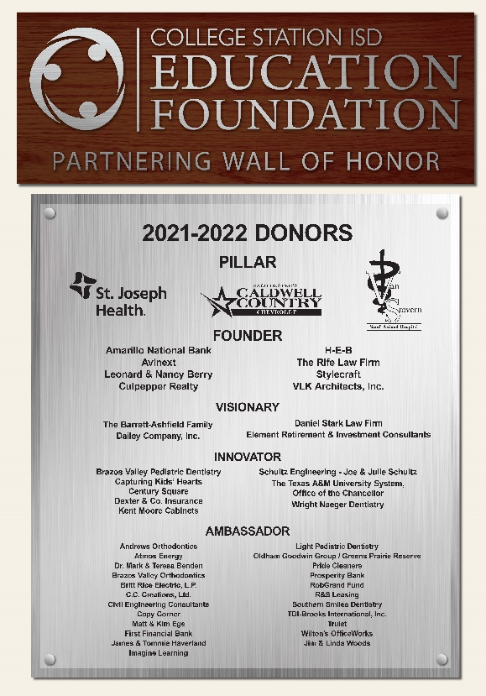
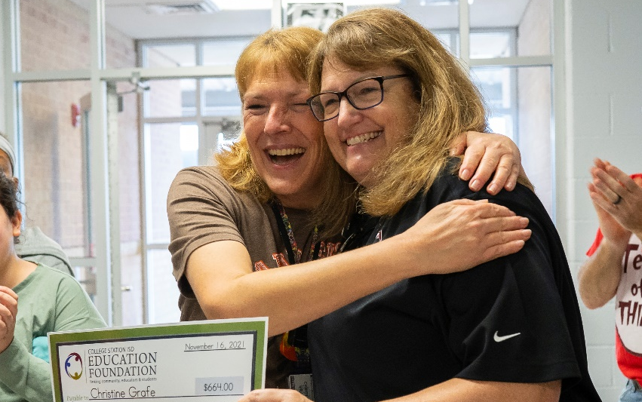
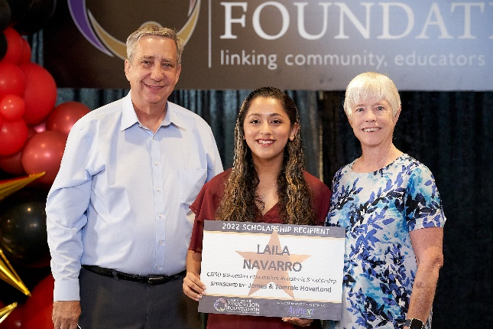
5th Annual Campaign
Total of $259,500 raised by 78 Partners
10 Title sponsorships raised $61,500
9 NEW Partners in 2021-22
2021-2022 Donor Wall

Slide 16
Top Non-Profit Participant for 3rd-year running
Total of $48,712 raised from 167 donors in 2021

Slide 17
Sources of EF Donations

Slide 18
How Donations are Allocated

Slide 19
2021-22 2020-21 % chg
Funds Raised $1,054,498 $ 649,284 62%
Program Funding $ 731,833 $ 479,373 53%
Net Ordinary Income $ 156,169 $ 77,558 101%
-------------------------------------------------------------------------------------------------
Endowed Scholarships $ 735,258 $738,621 - .4%
Board Rest Acct. $1,249,339 $1,432,621 -13%
Total Assets $2,132,056 $2,317,884 - 8%

Slide 20
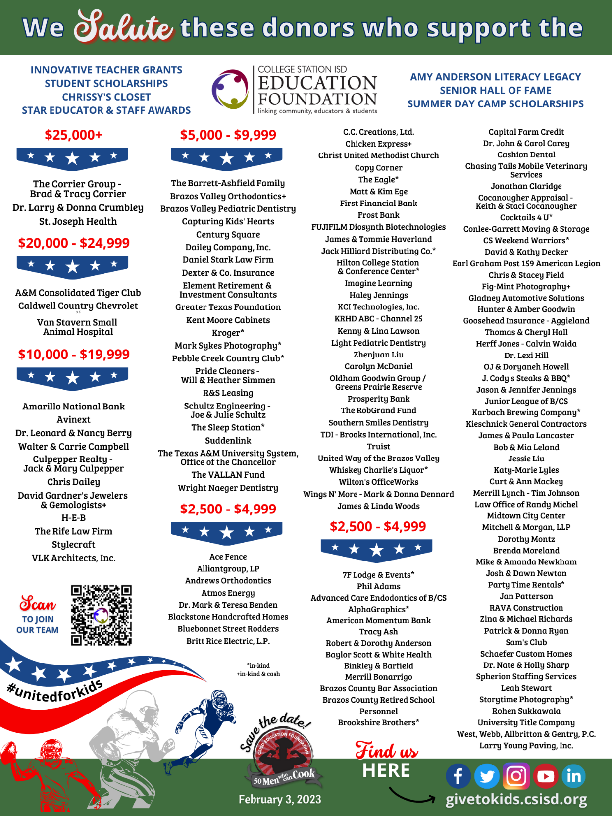
Donors who gave over $1,000 this past year
Ad to be run in the Tiger and Cougar football programs

Slide 21
