Slide 1
2020-2021
Annual Report

Slide 2
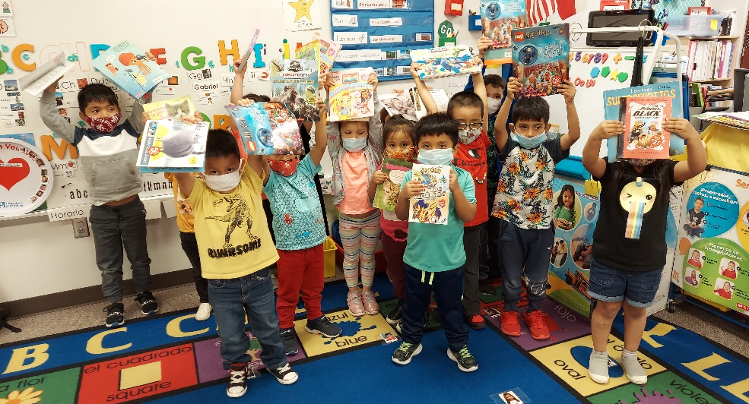
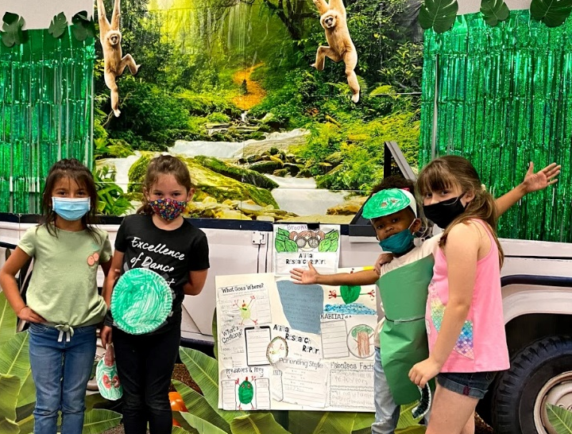
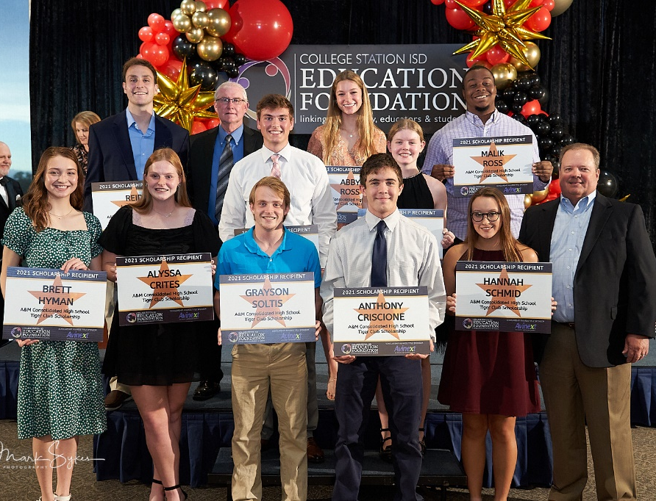
Our Mission
To provide resources that . . .
inspire learning
enrich teaching
recognize the successes of
our students and teachers

Slide 3
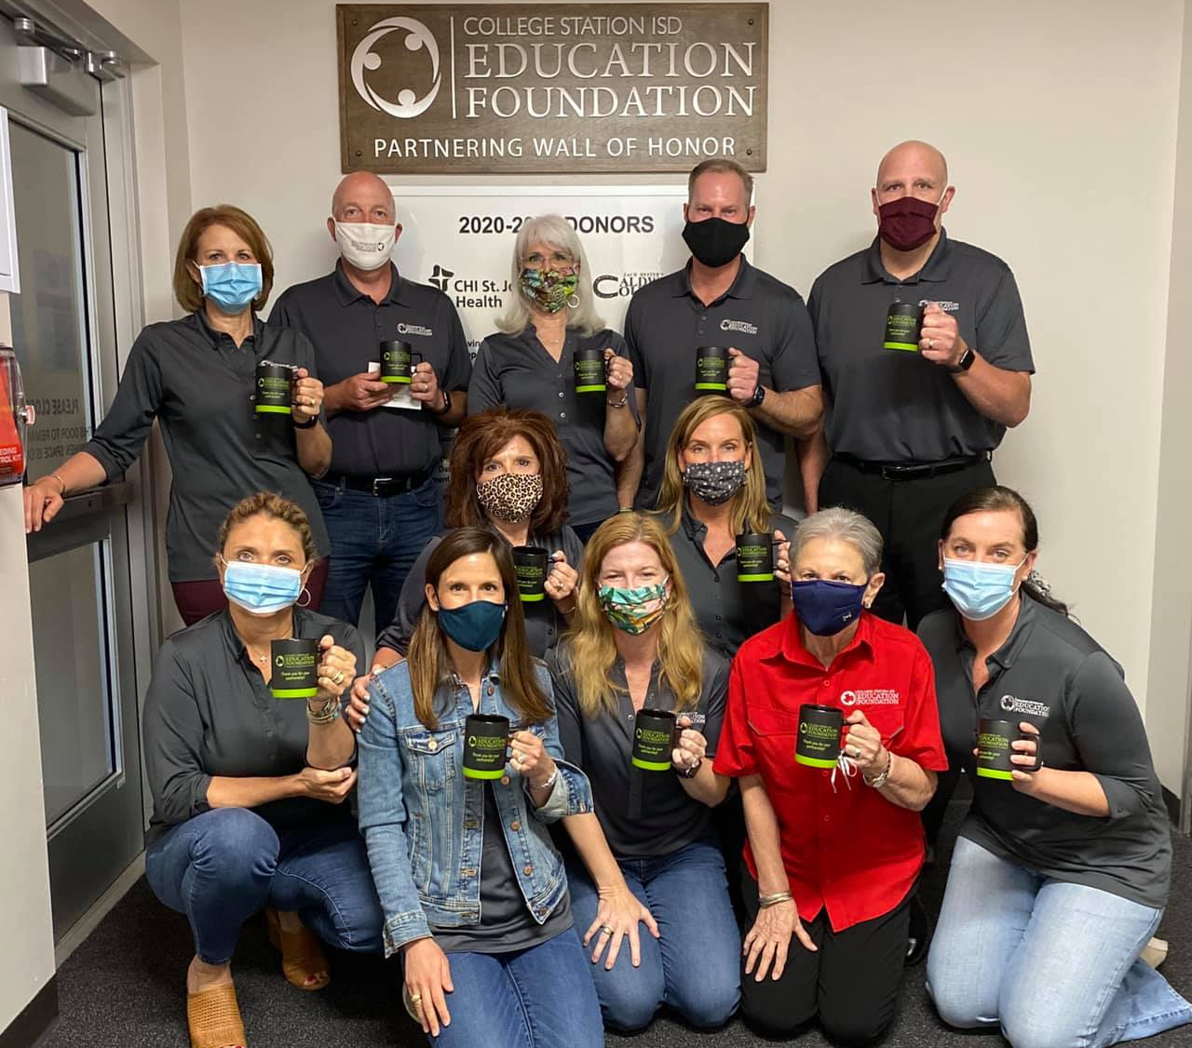
Board of Directors
Executive Committee
Jody Ford
President
Nancy Berry
President Elect
Heather Simmen
Past President
Steve Boswell
Treasurer
Paula Lancaster
Secretary
Committee Chairs
Staci Cocanougher
Mary Culpepper
Margo Dailey
Curt Mackey
Mike Newkham
Clayton Rhoades
Katy Scott
Christi Voelkel
EF Director
Teresa Benden
Members at Large
Dr. John Andrews
Gerry Brown
Annette Browne
Brad Corrier
Jim Davis
Rachelle Gardner
Jeff Horak
Jennifer Jennings
Bill Lartigue
Kenny Lawson
Mike Martindale
Mike McBerty Stephanie Moon
Suzanne Neuberger
Geralyn Nolan Robert Orzabal
Julie Schultz
Sue Shankar
Kelly Wood

Slide 4
Notable Accomplishments 2020-2021
Raised over $640,000 during a pandemic
(without 50 Men Who Can Cook, our main fundraiser)
Received $20,000 in Grant Funding from outside sources
Surpassed $11,000 in Star Educator donations
(84% inc over LY)
Awarded $130,200 in scholarships
(103 seniors- the most ever!)
Hosted the Senior Hall of Fame Banquet
and Scholarship Awards ceremony in person!

Slide 5
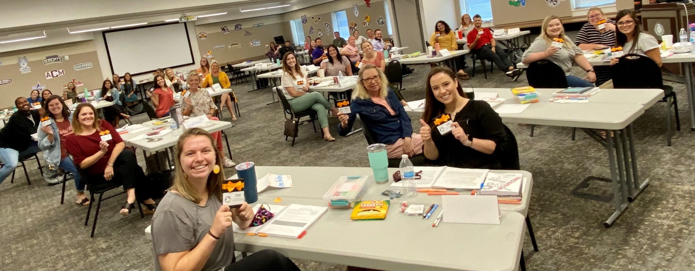
1st-Year Teacher Gift Card Program
37 first-year teachers received a
$100 Amazon gift card to get their
classrooms up and running
6th year for this program
Title Sponsor
Anonymous retired CSISD teacher

Slide 6
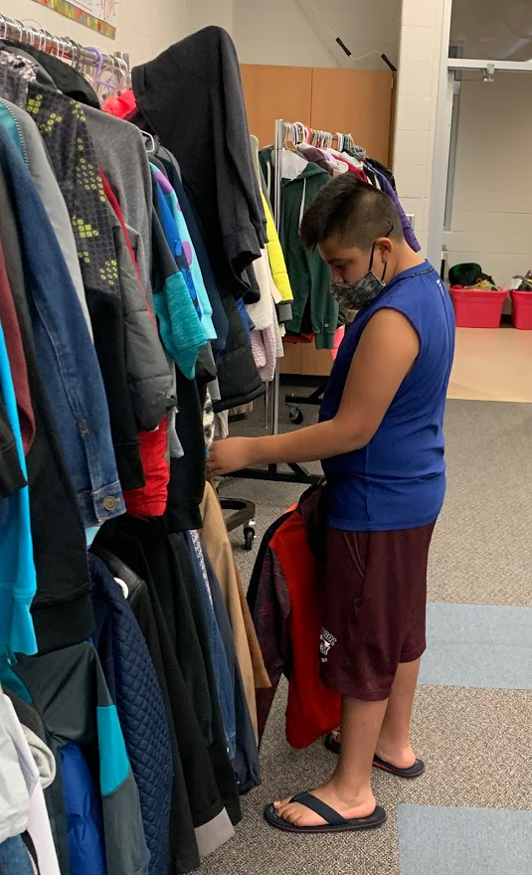
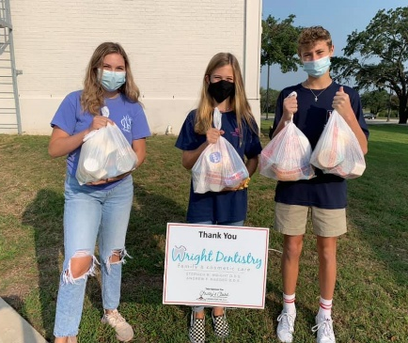
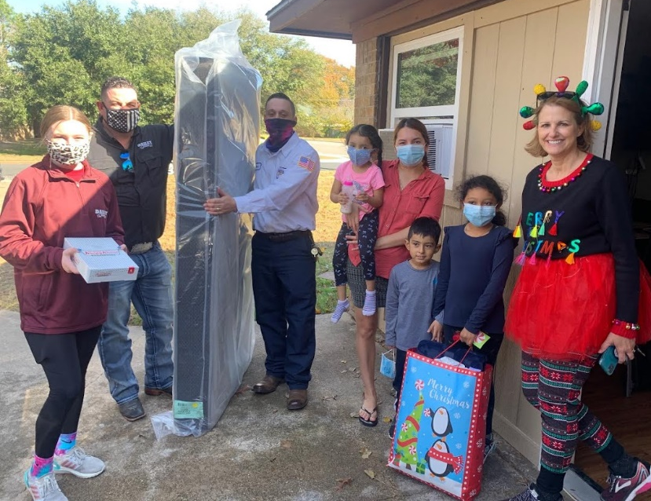
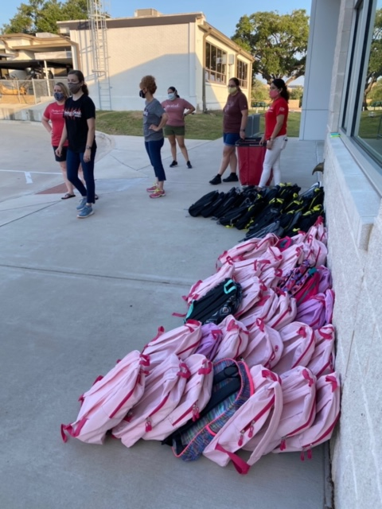
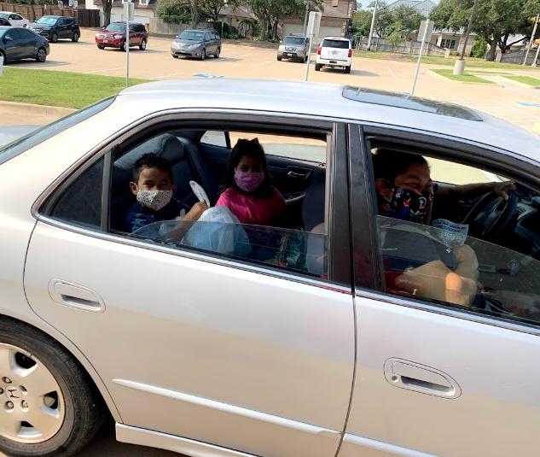
Title Sponsor
1,621 total visits
3,826 pieces of clothing
2,954 toiletries
2,087 socks and undies
351 pairs of shoes
3,499 food items
Delivered 62 mattresses

Slide 7
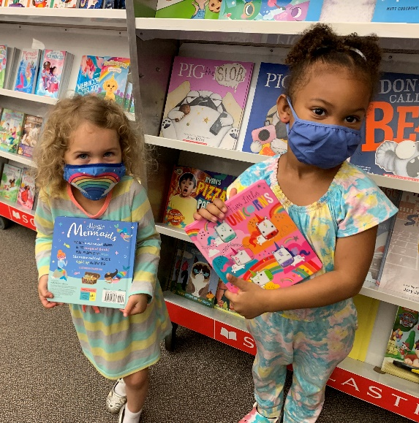
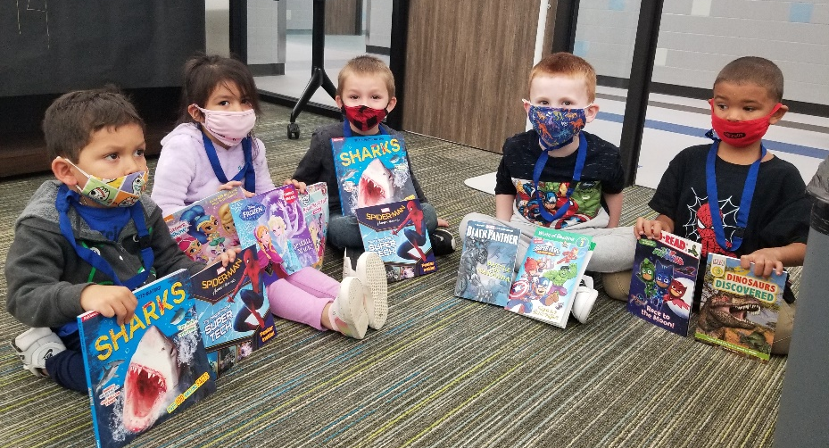
Amy Anderson Literacy Legacy
A book voucher program for young readers
656 Pre-K & Head Start students were given
$10 book vouchers to purchase books at fair
142 Pre-K & Head Start virtual students were given pre-filled book bags
400 Kindergarten & 1st Graders were also
given vouchers this year thanks to rollover $
Title Sponsor

Slide 8
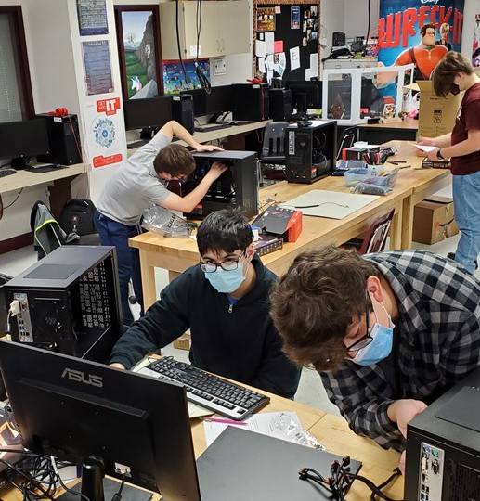
Innovative Teaching Grants
Awarded 45 grants totaling $172,471
In 22 years,
616 grants have been awarded
totaling $1,655,135!
Grant Patrol Sponsors

Slide 9
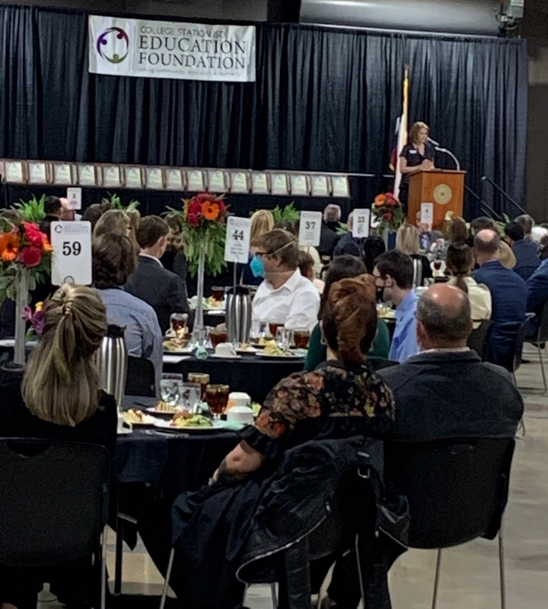
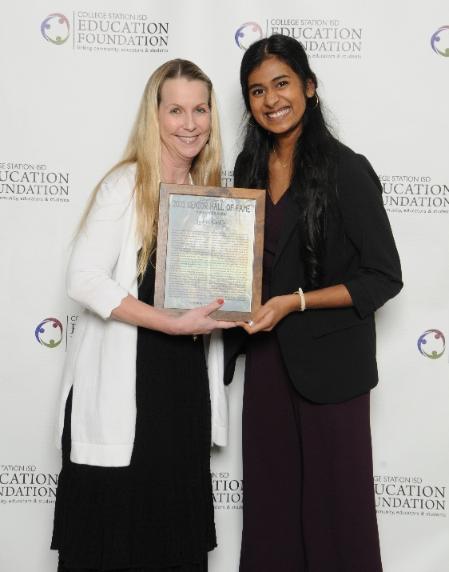
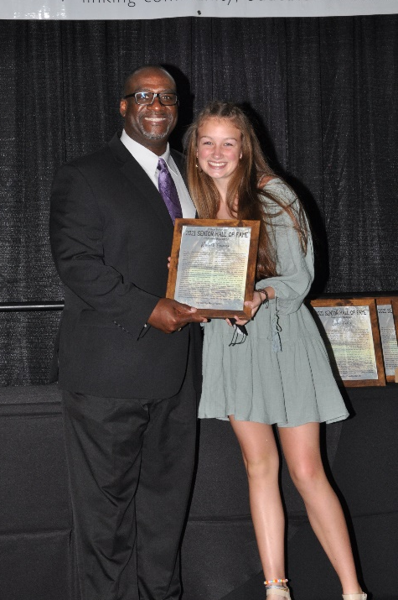
Senior Hall of Fame
Recognized 65 outstanding seniors and their chosen educators. Seniors were chosen based on integrity, leadership, dedication to their school and positive attitude.
Hosted live event at the Brazos County Expo
and social distanced guests.
The Hilton still catered the meal.
1,035 students and their chosen educators honored since 2000
Title Sponsor
The Barrett Ashfield Family

Slide 10
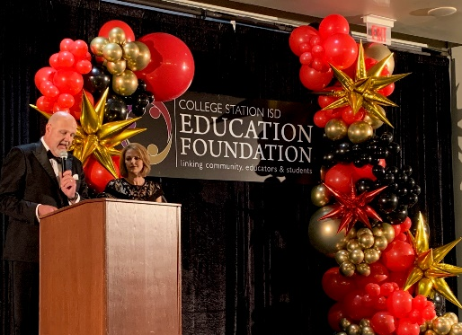
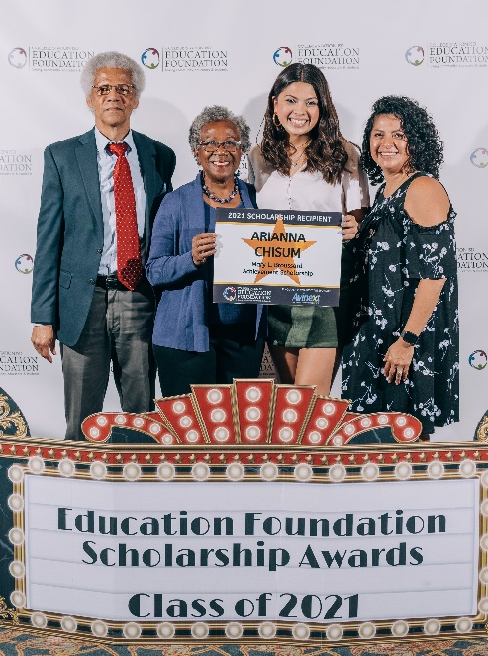
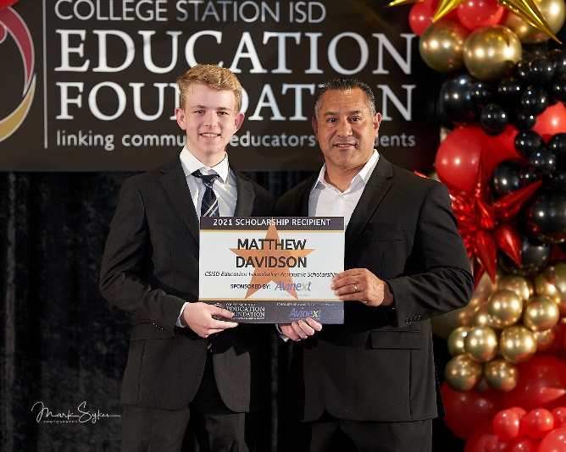
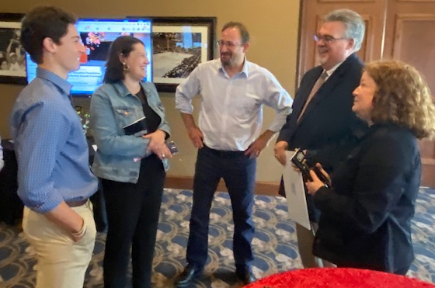
Student Scholarships
Awarded 103 senior scholarships totaling $130,200
Red carpet ceremony at Pebble Creek Country Club
Donors & seniors arrived every 15 minutes
Manage 16 Endowed scholarships worth $688,208
Awarded $807,350 over the past 22 years
Title Sponsor

Slide 11
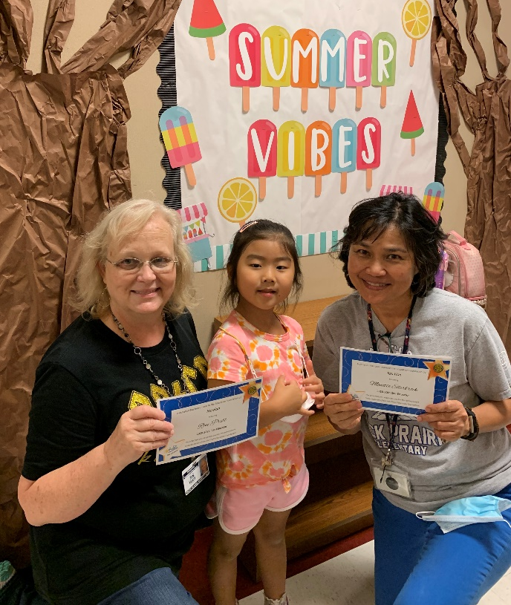
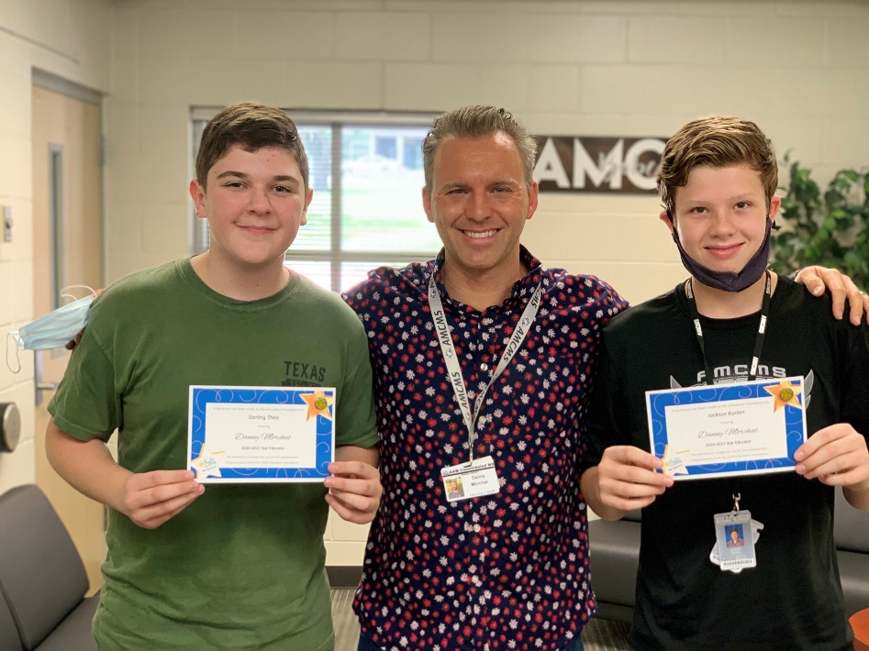
Star Educator
A teacher & staff recognition program
492 Teachers & Staff recognized
$11,067 raised this year (84% inc. over LY)
$91,446 raised through this program since 2002
Title Sponsor

Slide 12
Summer Day Camp Scholarships
Program started in 2020 to supplement Summer Day Camp for students in need
Raised $18,620 this year from individual donors + $11,818 rollover from last year
Sponsored 28 kids this summer for 9-week program at $1,170 per child. Family pays $10/week.

Slide 13
50 Men Who Can’t Cook 2021
Cancelled annual fundraiser due to
COVID concerns
Ran ad in The Eagle to thank sponsors
Save the Date:
Feb. 4, 2022

Slide 14
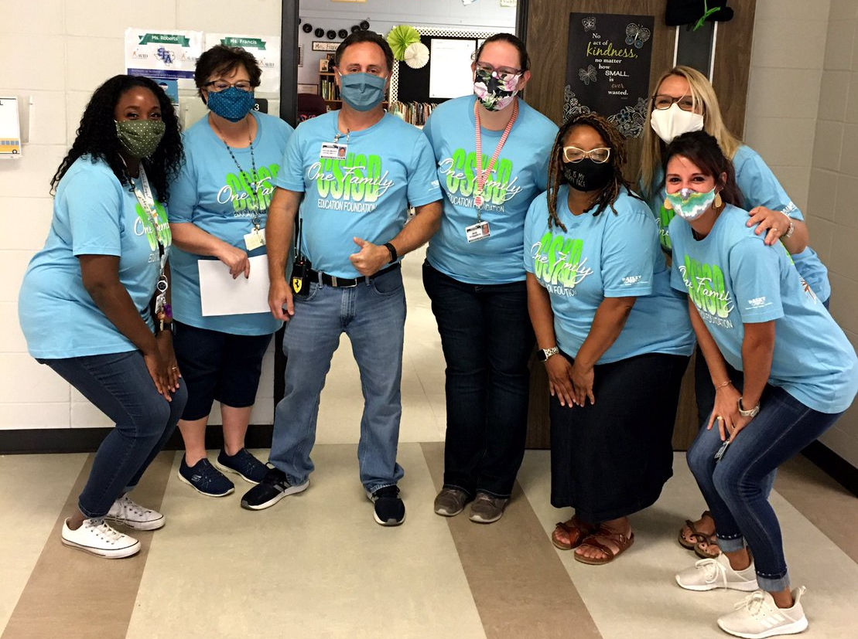
10th Annual Employee Giving Campaign
Total of $142,563 contributed for 2020-21
1,052 Employees giving (51% of employees)
6th year for Employee Rebate to campuses - $56,735 total unrestricted funds awarded to schools
Title Sponsor
2020-2021 Campus Champions

Slide 15
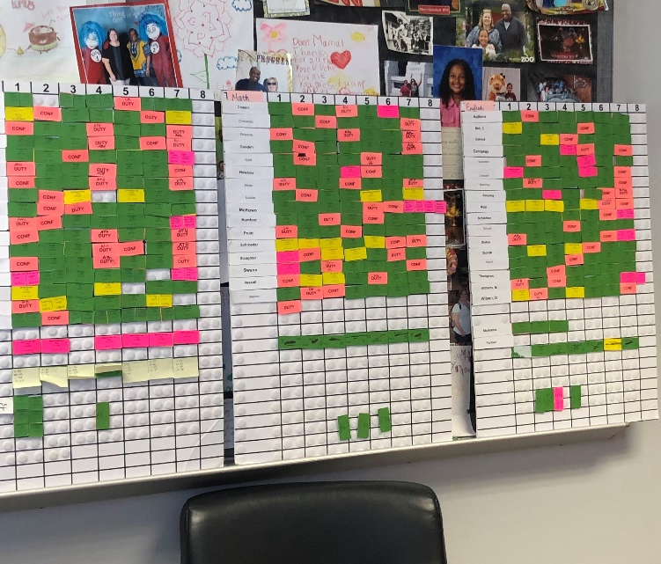
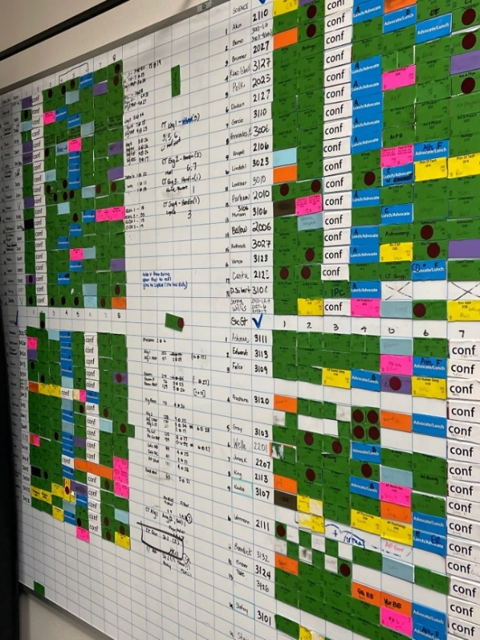
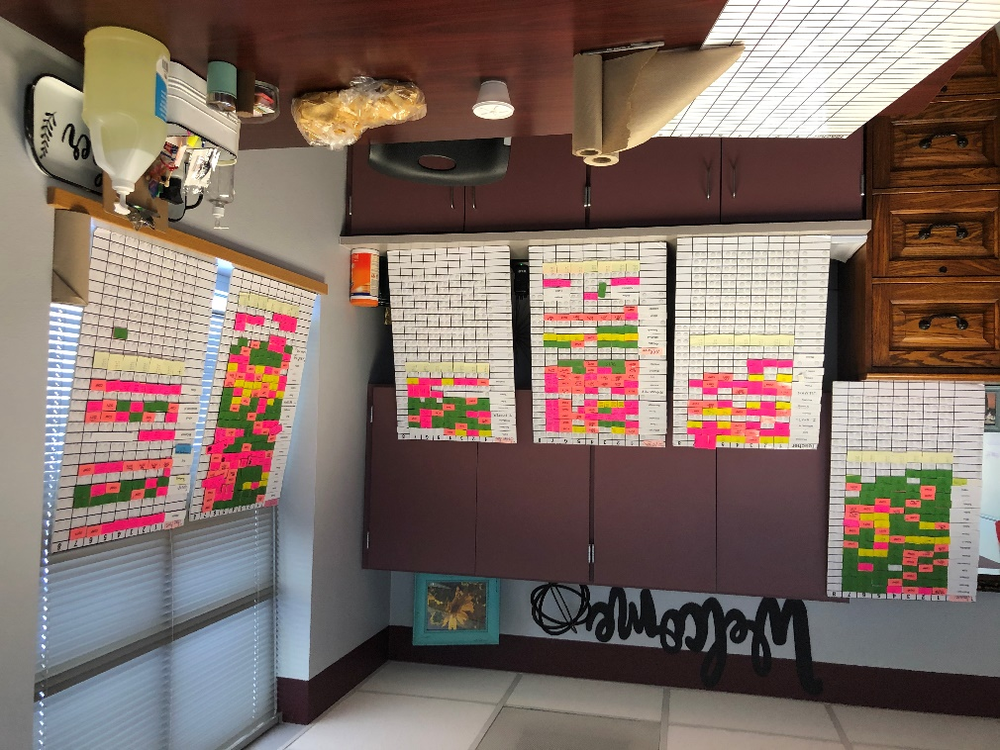
Special Projects - Cardonex Software
Scheduling software to replace current boards for intermediate, middle & high school counselors ($25,000 grant)

Slide 16
Sources of EF Donations~$649,908
*50 Men Fundraiser usually accounts for 21%

Slide 17
Program Support Allocations~$479,572

Slide 18
CSISD EF Year-End Financials at a Glance
2020-21 2019-20 % chg
Funds Raised $649,908 $827,712 -26%
Program Funding $479,572 $426,102 12%
--------------------------------------------------------------------------------------------
Endowed Scholarships $738,621 $503,000 47%
Board Rest Acct. $1,432,621 $1,146,113 25%
Total Assets $2,171,242 $1,649,113

Slide 19
2020-2021
DONORS
Donors who gave over $1,000 this past year
Ad to be run in the Tiger and Cougar football programs

Slide 20
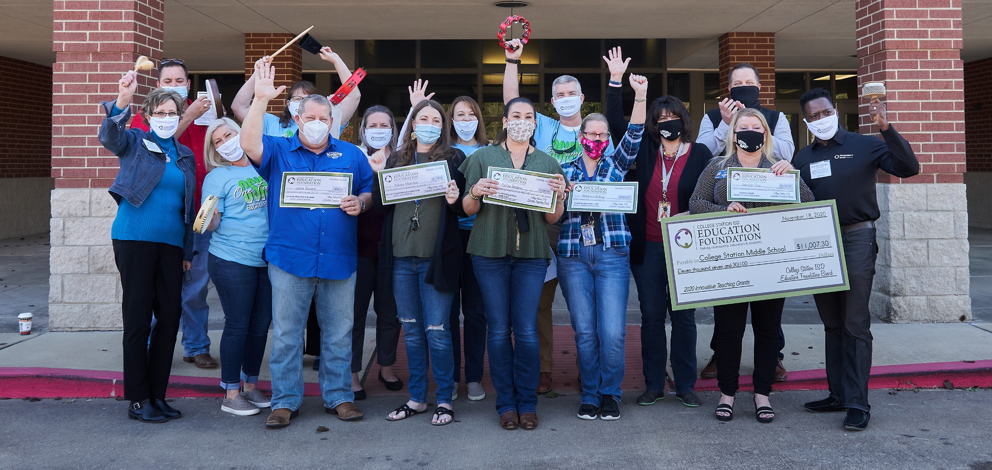
Thank you to our community for their support!

